Slide 1
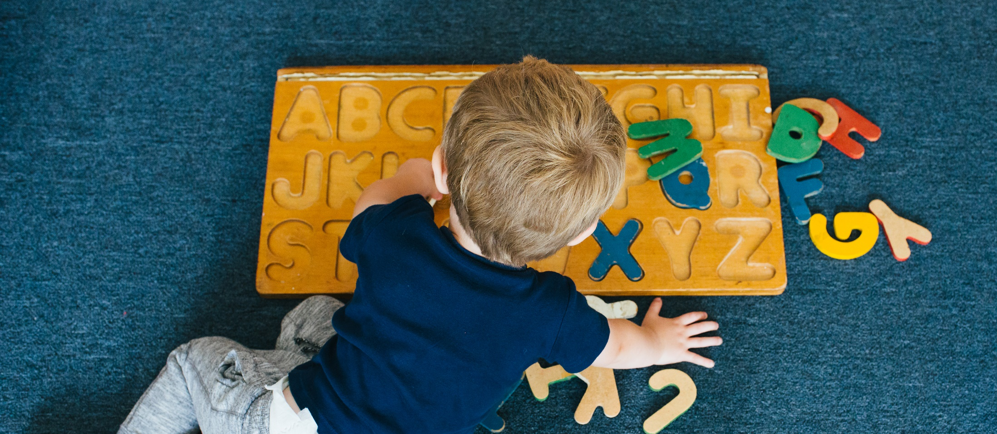
Home Safety for Family Child Care:
Indoors
Notes:
Notes:
Welcome to today’s presentation, Home Safety for Family Child Care: Indoors

Slide 2
Child Care Nurse Consultants
Stephanie Knutson, EdD, RN
Sahony Ramirez, BSN, RN
Notes:
Notes:
My name is ______________________, and I am a Nurse Consultant with the CT Nurses’ Association. I'm happy to be here today and to continue our discussion about home safety. We hope that this information will help you become
more aware of safety hazards and that you will share this information with families.
I have my colleague with me here today, Sahony, please say hello.
Joining this virtual event is an important opportunity to discuss important topics directly related to your work, engage with experts and most importantly with your colleagues.
Before we begin, we will review some important logistics so that you can get the maximum benefit from today’s platform.

Slide 3
Take Note
Recording this Session
Certificate & Evaluation
Notes:
Notes:
Today’s presentation is being recorded and will be available later from CT Nurses’.
If you have something of a confidential nature to discuss, please share that individually with CT Nurses at ctnurses@gmail.com
Upon completion of today’s training you will be directed to a link.
You must click the link and complete the evaluation to receive your certificate.
Please save your certificate at that time.

Slide 4
Interactivity
Chat box
Polls
Q & A
Video
Microphone off when not talking
Breakout Rooms
Notes:
Notes:
We have intentionally planned this event to support interaction with the speakers and with each other.
[ Presenter: read the slide]
Assisting with today’s webinar is my colleague at CT Nurses’, Michelle Caramanello. Michelle will be providing technical support and assisting with the polling questions.

Slide 5
Evaluation/Certificates
100 % Attendance
Evaluation
Certificate
Notes:
Notes:
In order to receive a certificate, you must:
Attend 100% of the webinar
Complete the evaluation
Download the certificate

Slide 6
2022 FCC Network Leader TOT Series Topics
February 2nd – Strategies for Preparing and Delivering Effective Presentations for FCC Providers
February 9th – Managing Infectious Diseases in FCC
February 16th - Home safety: Indoors
February 23rd - Home safety: Outdoors
Registration: www.CTNurses.org
Notes:
Notes:
The 2022 FCC Network Leader Train-the-Trainer Series includes four sessions during the month of February, on Wednesdays from 9:30 am to 11:30 am.
In the first session, we providing you with important tips and strategies for how to effectively prepare, deliver, and engage with your Regional FCC providers during training sessions.
In the 2nd through 4th sessions, we will walk you through 3 topics and demonstrate how you provide these topics to your FCC providers. After each of these demonstrations, you as FCC Network Leaders, will be able to use these same PowerPoints to train the FCC providers in your region. Today is the 3rd session.
We have provided notes on each slide as a guide for you to use when conducting the three (3) training sessions.
We have also provided these PowerPoints in both English and Spanish.
The 3 topics you will be able to deliver to your FCC providers are listed on the screen and includes:
Managing Infectious Diseases in FCC;
Home safety: Outdoors; and
Home safety: Indoors.

Slide 7
Home Safety: Indoors
<Add organization Name Here>
<Add Presenter Name here>
<Insert Date here>
<Add your logo here>
Notes:
Note:
When you begin your presentation, you should always start with an Introductory page or Title page that includes:
The title of the presentation
Name of your organization
Name of presenter
Date of presentation
Add your organization’s logo (optional)
This slide is a template so that you can add the specific details about yourself and the organization you represent.

Slide 8
Home Safety: Indoors
<Add organization Name Here>
<Add Presenter Name here>
<Insert Date here>
<Add your logo here>
Notes:
Note:
When you begin your presentation, you should always start with an Introductory page or Title page that includes:
The title of the presentation
Name of your organization
Name of presenter
Date of presentation
Add your organization’s logo (optional)
This slide is a template so that you can add the specific details about yourself and the organization you represent.

Slide 9
Learning Objectives
Describe characteristics of safe indoor environments
Discuss safety strategies for indoor furniture and materials
Discuss safe supervision strategies for indoors
Notes:
Notes
Our learning objectives for this session include:
Describing characteristics of safe indoor environments
Discussing safety strategies for indoor furniture and materials, and
Discussing safe supervision strategies for indoors
References:
https://childcare.extension.org/creating-a-child-care-environment-that-supports-childrens-exploration/
https://www.virtuallabschool.org/preschool/safe-environments/lesson-1
Checklist example: Indoor and Outdoor Safety Checklist for Child Care Centers
https://www.procaresoftware.com/resources/indoor-and-outdoor-safety-checklist-for-child-care-centers/#:~:text=Make%20sure%20all%20furniture%2C%20equipment,climbed%20on%20by%20a%20child.

Slide 10
What we know about injuries
Many childhood injuries are predictable and preventable!
FCC providers can CREATE SAFE ENVIRONMENTS AND ACTIVELY SUPERVISE take action to prevent injuries in FCC environments
Notes:
Notes
We know that injury is still the leading cause of death for children and teens in the United States.
Yet, many childhood injuries are predictable and preventable!
Importantly, FCC providers can take action to prevent injuries in FCC environments.

Slide 11
Why do young children have high rates of injury?
Let’s Chat
Notes:
Debrief:
Developing coordination and body awareness
Developing motor movement skills
Lack judgement – do not yet understand what is dangerous, they are learning thi
Lack physical skills to move away, for instance if they are placed in a tub with scalding hot water, they can not move themselves from the hot water

Slide 13
Latest Data On Child Injury Deaths
Notes:
Notes
In 2018–2019, child unintentional injury death rates were highest among:
Male children
Babies under 1 year old and teens age 15–19 years
American Indian and Alaska Native children and Black children
Motor vehicle crashes caused more deaths than other causes of unintentional injury.
Overall unintentional injury death rates in rural areas were higher than metro and urban areas.
Despite overall decreases in child unintentional injury death rates from 2010 to 2019, rates increased among some groups. For example:
Suffocation death rates increased 20% among infants overall and 21% among Black children
Motor vehicle death rates among Black children increased 9% while rates among White children decreased 24%
Poisoning death rates increased 50% among Hispanic children and 37% among Black children, while rates among White children decreased by 24%
Drowning was the leading cause of injury death for children age 1-4 years.
Drowning death rates were 2.6 times higher among Black children age 5–9 years and 3.6 times higher among Black children age 10–14 years, when compared with White children of the same age.
The CDC conducts research to better understand these disparities and puts science into action to improve health equity. As an example of this work, CDC is working with partners to identify barriers to participation in basic swimming and water-safety skills training among youth who are at higher risk of drowning due to racial and ethnic disparities.
Source: CDC (9/22/21) https://www.cdc.gov/injury/features/child-injury/index.html#Child-Injury-Deaths-Data

Slide 14
Child Injury Deaths (Fatal)
Suffocation
Drowning
Notes:
Notes
In 2018–2019, child unintentional injury death rates were highest among:
Male children
Babies under 1 year old and teens age 15–19 years
American Indian and Alaska Native children and Black children
Motor vehicle crashes caused more deaths than other causes of unintentional injury.
Overall unintentional injury death rates in rural areas were higher than metro and urban areas.
Despite overall decreases in child unintentional injury death rates from 2010 to 2019, rates increased among some groups. For example:
Suffocation death rates increased 20% among infants overall and 21% among Black children
Motor vehicle death rates among Black children increased 9% while rates among White children decreased 24%
Poisoning death rates increased 50% among Hispanic children and 37% among Black children, while rates among White children decreased by 24%
Drowning was the leading cause of injury death for children age 1-4 years.
Drowning death rates were 2.6 times higher among Black children age 5–9 years and 3.6 times higher among Black children age 10–14 years, when compared with White children of the same age.
The CDC conducts research to better understand these disparities and puts science into action to improve health equity. As an example of this work, CDC is working with partners to identify barriers to participation in basic swimming and water-safety skills training among youth who are at higher risk of drowning due to racial and ethnic disparities.
Source: CDC (9/22/21) https://www.cdc.gov/injury/features/child-injury/index.html#Child-Injury-Deaths-Data

Slide 15
Child Injuries Nonfatal
Motor vehicle crashes
Suffocation
Drowning
Poisoning
Fire/Burn
Falls
Notes:
Notes
Leading causes of child unintentional injury include motor vehicle crashes, suffocation, drowning, poisoning, fires, and falls.
Source: CDC: Injuries Among Children and Teens (9/22/21)
Https://www.cdc.gov/injury/features/child-injury/index.html#Child-Injury-Deaths-Data

Slide 16
Major Causes of Nonfatal unintentional injuries for children (0-19)
Motor vehicle crashes
Suffocation
Drowning
Poisoning
Fire/Burn
Falls
Notes:
Notes
Leading causes of child unintentional injury include motor vehicle crashes, suffocation, drowning, poisoning, fires, and falls.
Source: CDC: Injuries Among Children and Teens (9/22/21)
Https://www.cdc.gov/injury/features/child-injury/index.html#Child-Injury-Deaths-Data

Slide 17
Injury Triangle
Child
Environment
Causes
Notes:
Notes:
It can seem like an overwhelming task to address home safety because our home environments are constantly changing.
For example, you may have child proofed your FCC and a parent drops in and she leaves her purse on the chair and it contains a bottle of medication.
Using the injury prevention triangle as a model for creating strategies to keep their children safe.
For instance, think about their child's temperament.
Is the child cautious or more likely to be fearless?
Has the child recently developed a new skill like crawling that may change how he interacts with the environment?
By setting up the environment and moving hazards in creating safe routines, you're minimizing the likelihood of exposure to objects that can be harmful to a young child.
So for example, when a parent leaves their purse on a chair in easy reach of a mobile infant, you as FCC provider can have them move it immediately to someplace else, so the child cannot reach it.

Slide 18
Falls
Notes:
Notes
Let’s talk about falls.
Falls are the leading cause of injuries to children ages birth to five and one of the major reasons that children go to the emergency room.
According to the Center for Disease Control and Prevention, In 2010, 2.8 million children visited an emergency department for fall-related injuries and 40 percent of them were toddlers.
That is almost 3,200 toddlers a day.
But FCC providers can play a key role in protecting children from falls.

Slide 19
Chat: What are some places children can fall indoors?
Notes:
Poll
Let's take a poll to find out some of the places where a child can drown. Please check all that apply.
A bathtub, a pool, a toilet, or a bucket? I'll give you a moment to complete the survey.
[Presenter: share the poll results]
Yes, children can drown in two inches of water, just enough to cover their nose and mouth.
So, all of these places are a potential place that a young child can drown.

Slide 20
Falls
Notes:
Notes
Let’s talk about falls.
Falls are the leading cause of injuries to children ages birth to five and one of the major reasons that children go to the emergency room.
According to the Center for Disease Control and Prevention, In 2010, 2.8 million children visited an emergency department for fall-related injuries and 40 percent of them were toddlers.
That is almost 3,200 toddlers a day.
But FCC providers can play a key role in protecting children from falls.

Slide 21
Protect Children form Falls
Staying within arm's reach of very young children whenever they are using playground equipment
Fastening the safety straps when children are sitting in a highchair or stroller
Always keeping a hand on a child while on elevated surfaces like a changing table
Keeping infant seats or bouncy seats on the floor, not on a table or raised surface
Using a gate at the bottom and top of the stairs
Notes:
Notes
Children are curious and love to explore, but their motor skills are still developing.
They can easily lose their balance and they're still learning how to tell what is safe.
As a result, children this age have many falls.
FCC providers can make their home safer by using inexpensive safety devices such as guards on windows that are above ground level and gates and guardrails on stairs.
Other safety tips includes:
Keeping furniture away from windows so children do not climb near and possibly fall out of an open window.
Never depending on screens to keep children from crawling out of windows.
Installing window locks so that windows open no more than four inches, and
whenever possible, open windows from the top, not the bottom.
Also, simple behaviors such as keeping a hand on the child while on a high place, such as a changing table or bed, and using safety straps in high chairs and strollers will go a long way towards preventing falls.

Slide 22
Protect Children from Falls
Staying within arm's reach of very young children whenever they are using playground equipment
Fasten the safety straps when children are sitting in a highchair, bouncey seat, swing or stroller
Stay hands on: Always keeping a hand on a child while on elevated surfaces like a changing table
Use equipment on the floor Keeping infant seats or bouncy seats on the floor, not on a table or raised surface
Use safety gates Using a gate at the bottom and top of the stairs
Notes:
Notes
Children are curious and love to explore, but their motor skills are still developing.
They can easily lose their balance and they're still learning how to tell what is safe.
As a result, children this age have many falls.
FCC providers can make their home safer by using inexpensive safety devices such as guards on windows that are above ground level and gates and guardrails on stairs.
Other safety tips includes:
Keeping furniture away from windows so children do not climb near and possibly fall out of an open window.
Never depending on screens to keep children from crawling out of windows.
Installing window locks so that windows open no more than four inches, and
whenever possible, open windows from the top, not the bottom.
Also, simple behaviors such as keeping a hand on the child while on a high place, such as a changing table or bed, and using safety straps in high chairs and strollers will go a long way towards preventing falls.

Slide 23
Suffocation/Airway Obstruction
Notes:
Notes
Let’s talk about falls.
Falls are the leading cause of injuries to children ages birth to five and one of the major reasons that children go to the emergency room.
According to the Center for Disease Control and Prevention, In 2010, 2.8 million children visited an emergency department for fall-related injuries and 40 percent of them were toddlers.
That is almost 3,200 toddlers a day.
But FCC providers can play a key role in protecting children from falls.

Slide 24
Furniture Tip Overs
Use guards on windows that are above ground level
Use gates to keep children from falling down stairs or going up stairs
Notes:
Notes
On average, more than 18,000 children, eight years and younger, are injured each year when a television, a piece of furniture, or an appliance falls on them.
Children may try to climb on a shelf or dresser or pull on furniture while trying to stand or trying to reach for a favorite toy or other object when the furniture topples over.
To prevent a tip-over tragedy, secure by anchoring heavy furniture and objects to the wall or floor so that they do not fall on to young children.
Reference:
Consumer Product Safety Commission reports

Slide 25
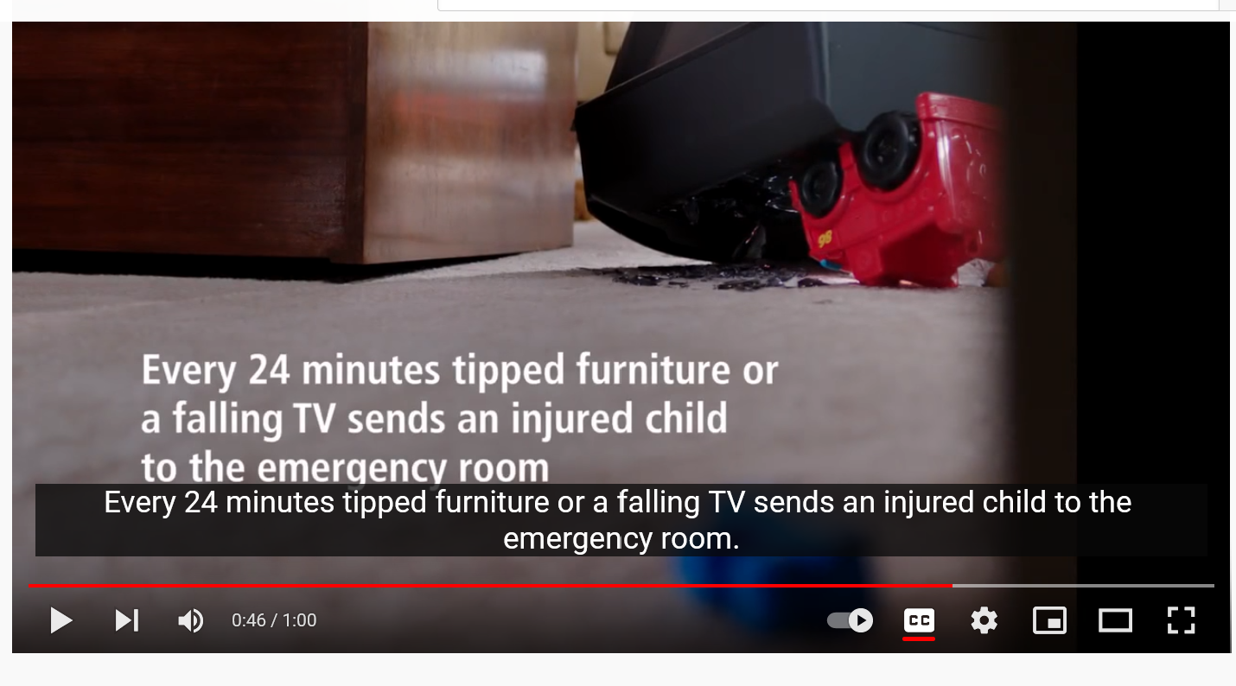
Anchor It
Notes:
https://youtu.be/g6oHH9GTzsg
https://youtu.be/3ZLKDLJX-0E

Slide 26
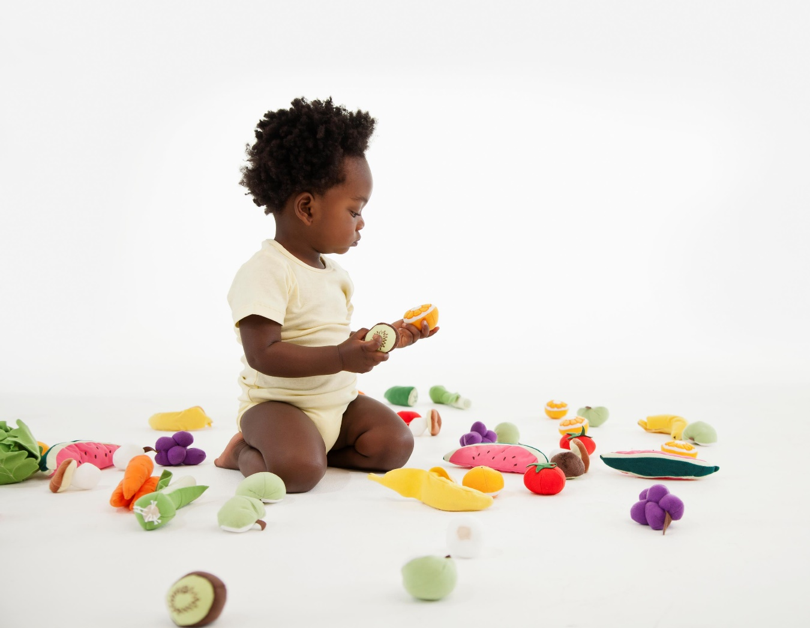
Airway Obstruction
Notes:
Notes
Airway obstruction is a leading cause of unintentional injury-related death among infants under age one and a major risk for children up to age four.
Young children are vulnerable to airway obstruction because they have small airways, are inexperienced chewers, and like to put objects in their mouth as they use all of their senses to explore the world.
This puts them at high risk for suffocation, choking, or an airway obstruction.
Airway obstruction applies to all the possibilities in which a piece of food or an object gets caught in a child's throat causing the child to choke, constricting of the child's neck which is known as entrapment, or something that blocks the child nose and mouth so he can't breathe which results in suffocation.
Infants can't lift their heads or move out of dangerous positions, so they are vulnerable to getting stuck in a position that inhibits their ability to breathe.
Airway obstruction can lead to permanent brain damage and even death.

Slide 27
Bare is best!
Notes:
Notes
Cribs are very at-risk to airway obstruction.
The distance between a flat and all dimensions of the crib and mattress are specified to prevent a child from entrapment.
The federal government recognized the importance of safe sleep spaces and published new crib standards that took effect in June 2011.
In addition to other changes, cribs with drop-down sides can no longer be sold and they should not be used in FCC.
These safety standards were designed to create a safe sleep environment for babies.
What goes into the crib keeps the child safe as well.
Bare is best. This means that it is best not to use a bumper pad, and FCC providers should never place pillows or thick quilts in the baby's sleep environment.

Slide 28
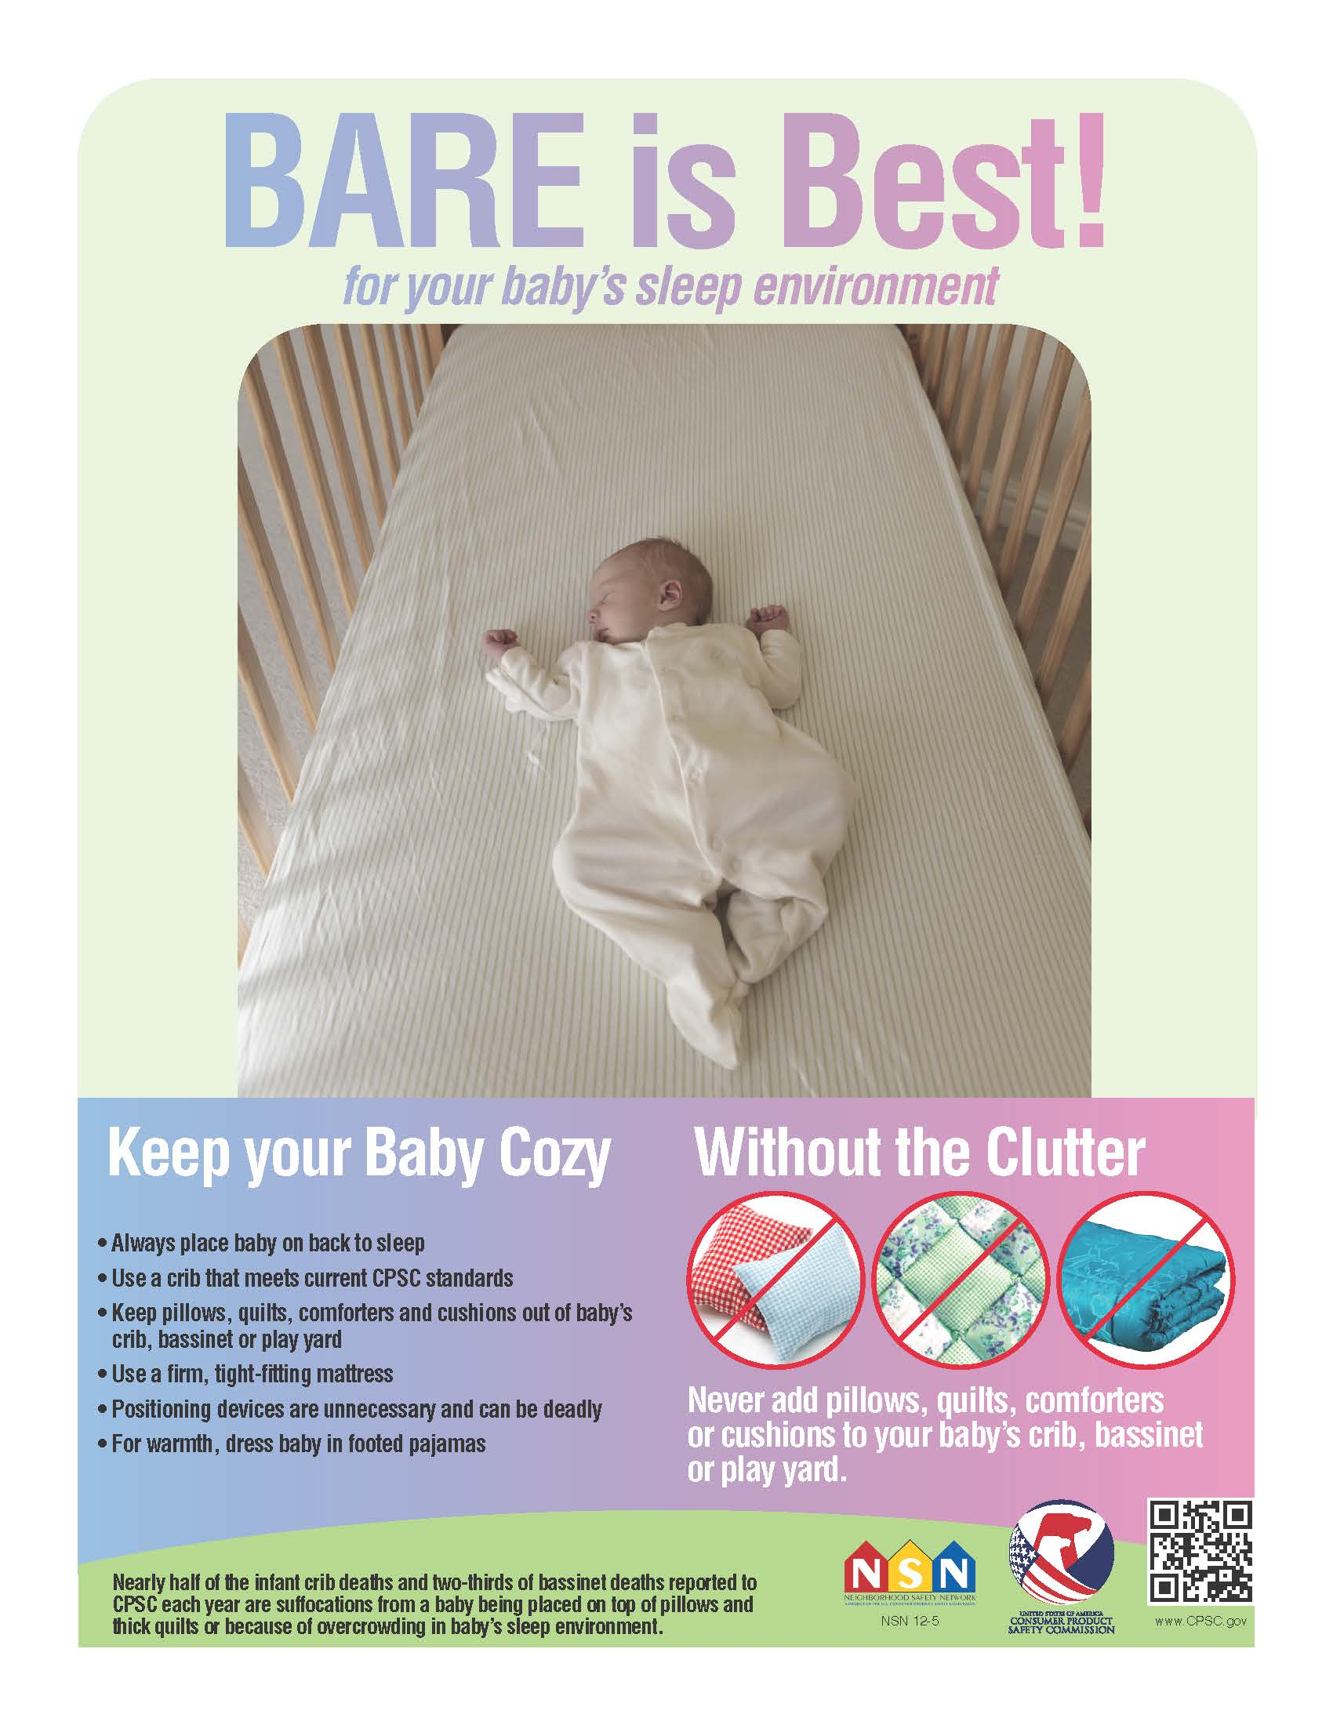
Safe Sleep
https://www.cpsc.gov/safety-education/safety-guides/kids-and-babies-cribs/safe-sleepbare-best
Notes:
Notes
Cribs are very at-risk to airway obstruction.
The distance between a flat and all dimensions of the crib and mattress are specified to prevent a child from entrapment.
The federal government recognized the importance of safe sleep spaces and published new crib standards that took effect in June 2011.
In addition to other changes, cribs with drop-down sides can no longer be sold and they should not be used in FCC.
These safety standards were designed to create a safe sleep environment for babies.
What goes into the crib keeps the child safe as well.
Bare is best. This means that it is best not to use a bumper pad, and FCC providers should never place pillows or thick quilts in the baby's sleep environment.

Slide 29
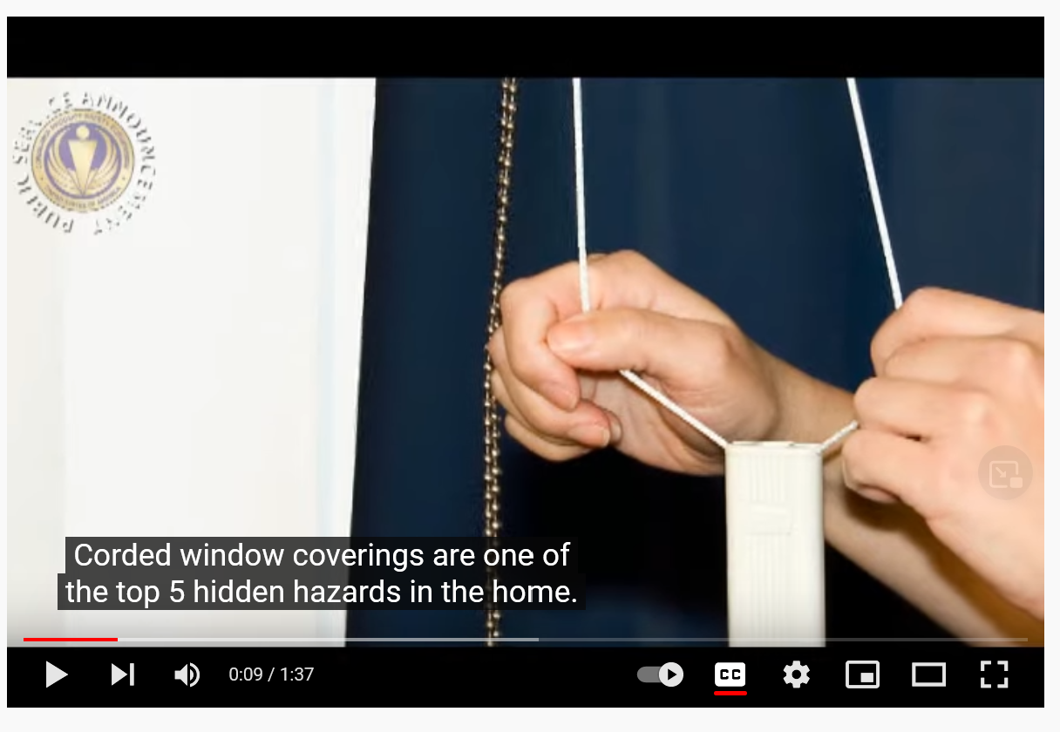
Window Cord Safety
https://youtu.be/mVSQcFduNac
Notes:
Notes:
There are many strangulation hazards such as window cords, clothing draw strings, ribbons, necklaces, and pacifier strings that could potentially get wrapped around a child's neck and strangle him.
Using cordless window coverings in great, but if not, there should be no acceptable loose cords on the front, side, or back of the product.
If the window covering has loop beaded chains or nylon cords, tension devices can be used to keep the cord taut.
Even cords and common appliances in the home, such as a baby monitor, can pose a risk to young children.

Slide 30
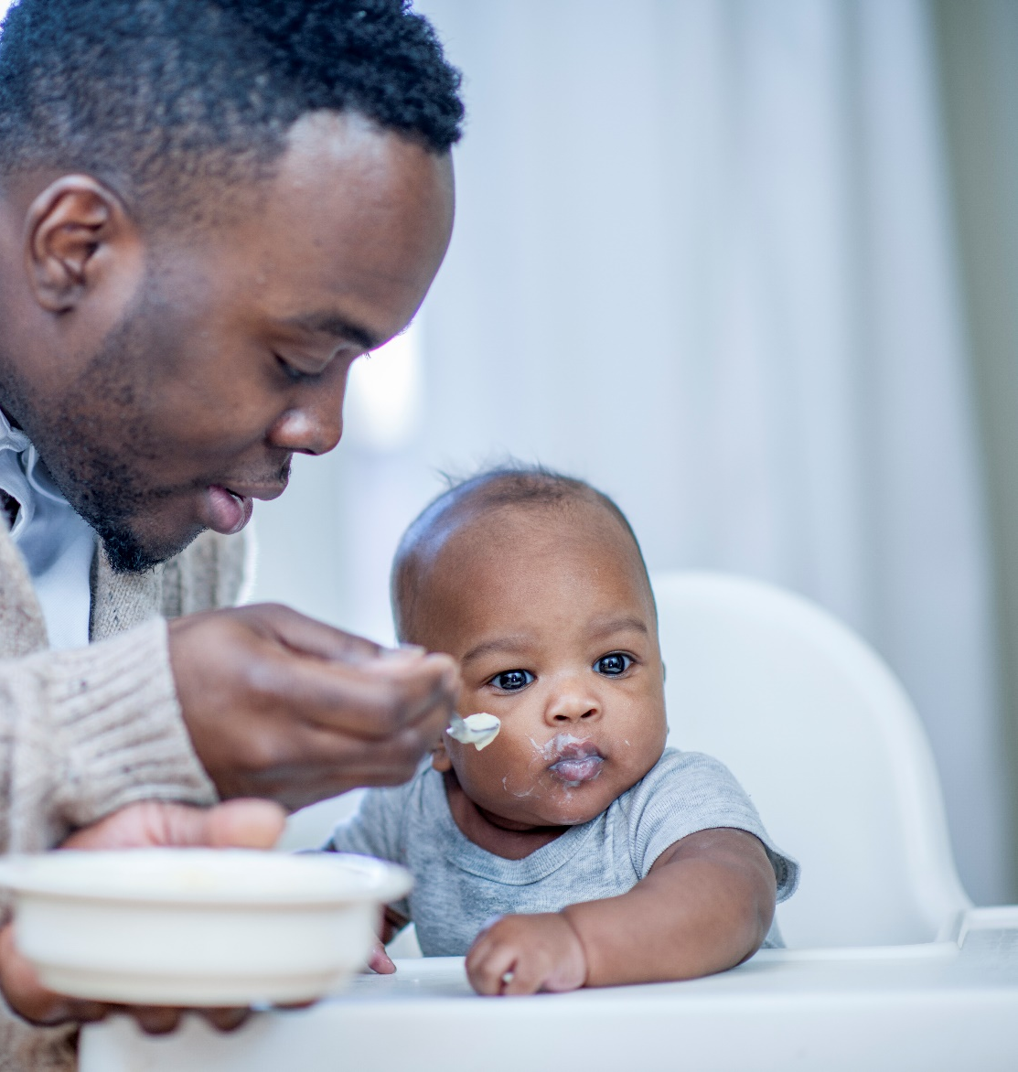
Choking Hazards
Notes:
Notes
Small objects can easily become lodged in the throat and obstruct the airway.
This is the most common cause of choking in young children.
90 percent of fatal choking occurs in children younger than four years of age.
FCC providers can protect children by simply cutting food into quarter-inch pieces for infants and half-inch or smaller for toddlers so that the pieces are small enough for children to safely swallow the food whole.
Also, establish safety rules such as a mealtime routine that requires the children to be sitting when eating and not allowing rough play at the table.
It is also a good idea for an adult to be nearby and have basic first aid skills so that if the child does choke immediate assistance can be provided.
Little objects and toys are another common choking hazard.
Sometimes, toys for older children have small parts. Remember to keep toys intended for older children out of the reach of babies and toddlers.
Ingesting a small magnet or battery will cause serious harm to a young child.
Small magnets can be found in children as well as some adult toys and may look like a toy or jewelry to a young child.
Button batteries can be found in remote controls, games, toys, and calculators and many other items around the home.
Swallowing a button battery can cause life-threatening or permanent disabling injuries to a child if it's not removed within two hours
Reference
Caring for Our Children: National Health and Safety Standards,

Slide 31
Identify choking hazards in the home
Notes:
Toys with small parts
Address the challenge in FCC that you have multi age groups _ infants/toddlers playing with 4 year olds, different toys that are developmentally appropriate.
How do FCC providers manage to provide developmentally appropriate toys and keep kids safe?
Talk about bringing out small parts when infants are napping, teaching and working with older kids to clean up and be sure all items are away to keep their friends safe…
Cutting up food: infants ¼ in and toddlers ½ in – in effective chewers
Important stay up to date in FA and CPR, choking is silent happen quickly
Check toys frequently for loose or small parts (like sewn on eyes on a bear)

Slide 33
Drowning
Notes:
Notes
According to the CDC:
More children ages 1–4 die from drowning than any other cause of death except birth defects.
Drowning happens in seconds and is often silent.
Drowning can happen to anyone, any time there is access to water.
Source:
CDC: Drowning Prevention. https://www.cdc.gov/drowning/

Slide 34
Poll: A young child can drown in?
Bathtub
Pool
Toilet
Bucket
Notes:
Poll
Let's take a poll to find out some of the places where a child can drown. Please check all that apply.
A bathtub, a pool, a toilet, or a bucket? I'll give you a moment to complete the survey.
[Presenter: share the poll results]
Yes, children can drown in two inches of water, just enough to cover their nose and mouth.
So, all of these places are a potential place that a young child can drown.

Slide 35
Drowning Risks
Notes:
Notes
Drowning can happen in a matter of seconds, and a child who falls in the water will quickly sink to the bottom and lose consciousness with little to no sound.
Most children drown in the presence of a supervising adult and within a few feet of safety.
Infants drown most frequently in the bathtub, while swimming pools pose the greatest risk to toddlers.
Adults should use touch supervision whenever a child is in or near a body of water.
Touch supervision means that an adult is always within arm's reach of a child.
Ensuring that children don't play in the bathroom can prevent them from drowning in toilets.
Routinely emptying buckets and pails used for household chores when you're done and emptying wading pools are other ways they can keep children safe.
It's never too early to begin to teach children rules about water safety.

Slide 36
Stay hands on
Use “touch supervision” whenever a child is in the bath or any other water
Notes:
Notes
We can't emphasize enough to always say "hands on" and use touch supervision whenever a child is in the bath or any other body of water.

Slide 37
Poison Prevention
Candy
Pills
Notes:
Notes
Poisons are hidden throughout your home but are also in plain view.
According to Safe Kids, half of the 2.4 million calls to the Poison Help Line in 2010 involved children ages five and under.
In fact, nine out of 10 poisonings occur in the home.

Slide 38
Poll
Daffodils
Cosmetics
Detergent
Toilet bowl cleaner
Notes:
Notes
Let's take a poll to identify places in the home environment.
Please select which items below are poison.
Daffodils, cosmetics, dishwasher soap detergent packets, or toilet bowl cleaner?
Please check all that apply.
I'll give you a moment to complete the poll.
[Presenter: Share the poll results]
I see that many of you are identifying toilet bowl cleaner, detergent, and some of you have even selected daffodils. And, yes, these are all poisons that can be found in the home environment.

Slide 39
Poison Prevention
Candy
Flowers
Notes:
Notes
Look at these pictures.
Some poisonous items come in brightly-colored packaging and resemble items that a child may think is a treat.
The one on the left are pieces of candy. The one on the right are flowers.
The two items may look the same to a young child. Most children cannot tell the difference between the orange color of a cleaning product and that of an orange drink.
Poison comes in many forms and can be found indoors and outdoors.
Poisons can enter the body from eating, drinking, touching, or smelling them.
According to Caring for Our Children, the top four items most involved in poison exposure among children include cosmetics, personal care products, cleaning substances, and medication.
As you can see, we use many items in our everyday lives that can be poisonous to a young child.
Children learn by imitation, and they copy adults that they see using medicines, cosmetics, or other substances that could be poisonous to a young child.
For instance, some things, like medicine, can make you sick if you take someone else's medicine or you take too much medicine.
It is important to remember that child-resistant packaging on medication is not child-proof.
Always store medicine up, away, and out of reach from all children.
And as a reminder, families should bring medications to your FCC in their original containers.

Slide 40
Poison Prevention Checklist
Picture of places where poison can be found:
Mushroom outside
Notes:
Notes
Throughout the discussion today, we've been talking about the most frequent types of injuries to young children such as falls, drowning, or poisoning.
You can use the home safety checklist to prevent these hazards.
These checklists are designed to help us recognize the injuries that are most likely to occur in each room of a house.
Thinking about what could be dangerous to a young child in each room of the house may be a helpful way to identify safety hazards in their home.

Slide 41
Poison Control
1-800-222-1222
Notes:
Notes
As FCC providers, you should know how to call the Poison Help Line if you believe a child has been poisoned or if they want to find out whether a substance may be harmful.
For example, even if a child has not been poisoned, FCC providers can still call the Poison Help Line with questions like:
Could this plant in my yard be harmful?
Posting the Poison Control Help Line number in a central location or adding it to a mobile phone makes it accessible during an emergency.
Poison Control is open 24 hours a day, 7 days a week, and can provide information on what to do to treat the child.

Slide 42
Fires/Burns
Notes:
Notes:
Fires and burns are a leading cause of injury-related death to children.
Every day at least one child dies from a home fire, and every hour approximately 14 children are injured from fires or burns.
Ninety percent of all fire-related deaths are due to home fires which spread rapidly and can leave families as little as two minutes to escape once an alarm sounds.
Children can also suffer serious burns that may limit their movement and cause scarring

Slide 43
Poll
How long does it take hot liquid to burn a young child?
(Check all that apply)
5 minutes at 120 degrees F
15 minutes at 133 degrees F
1 second at 156 degrees F
Notes:
Notes
So, we wanted to take another poll to find out what you think about how long it would take a hot liquid to burn a young child.
Do you think that it takes five minutes at 120 degrees Fahrenheit?
Or 15 seconds at 133 degrees Fahrenheit?
Or only one second at 156 degrees Fahrenheit?
Please check all the answers that you think apply, and we'll share the results with you in just a minute.
[Presenter: share the poll results]
So, the answer is that all of these are true. In fact, a child will be burned in any of these examples.

Slide 44
Scalds
Notes:
Notes:
Many ordinary things in a home, from bath water and hot food to electrical outlets, can cause childhood burns.
A child's skin is much thinner than an adult's and can burn at temperatures that adults would find comfortable.
Setting a water heater at or below 120 degrees Fahrenheit is one way to protect children from burns.
Tap water burns most often occur in the bathtub and tend to be more severe because they cover a larger portion of the child's body than other types of scalding.
This is why it's important for FCC providers to always test the temperature water before using it on a child.
Some other safety tips to prevent burns include:
Placing hot foods and liquids in the center of a table or at the back of a counter so they're harder to reach.
Not holding a baby or small child while cooking, drinking, or carrying any hot foods or liquids
turning pot handles towards the back of the stove, so that they can't be grabbed.
Never heating baby bottles in a microwave. It's best to use warm water from the faucet instead, And
never letting a child remove any food from the microwave or leaving children alone in the kitchen while cooking

Slide 45
Fire Safety Checklist
Smoke Alarms
Cooking Safety
Candle Lighter, and Match Safety
Escape Plan
Carbon Monoxide Alarms
Electrical and Appliance Safety
Resource: https://www.usfa.fema.gov/downloads/fief/up_in_smoke_caregivers_checklist.pdf
Notes:
Notes
According to Safe Kids, working smoke alarms reduce the chances of dying in a fire by nearly 50 percent.
But in order to be effective, they have to work properly.
Smoke alarms should be in every sleeping area and on every level of a home.
Checking the batteries in smoke alarms at least twice a year when we change our clocks, one good way to remember to do so.
Cooking equipment is the leading cause of home fires, so it's recommended that smoke alarms be placed at least ten feet away from cooking appliances.
Some recent studies have shown that smoke alarms may not always wake children up, so FCC providers will need to come up with a plan of escape
Carbon monoxide detectors also save lives, as carbon monoxide is an odorless invisible gas that can't be seen or smelled.
If there are adults in your FCC home who smoke, remember to keep cigarettes, matches, lighters, and other smoking materials out of reach of children, in a locked cabinet, and always dispose of cigarettes properly.
It's a good idea to create a kid-free zone of at least three feet around open fires and heat forces such as stoves, fireplaces and wood-burning stoves, space heaters, and grills. And keep anything that can burn at least three feet away from a heat source
Resource:
FEMA: Fire Safety Checklist for Caregivers of Babies and Toddlers. https://www.usfa.fema.gov/downloads/fief/up_in_smoke_caregivers_checklist.pdf

Slide 46
Child Passenger Safety
Notes:
Notes
As we discussed earlier, many children experience motor vehicle injuries, so we've included transportation safety because families have to travel to and from a variety of locations, including to FCC.
FCC providers and families can keep children safe by knowing how to use car seats, booster seats, and seat belts, and using them on every trip.
Children are great imitators, so encourage families to be good role models and create good habits by always fastening their own seat belts.

Slide 47
Poll: The number of people who think they are using the right car seat for their child?
1 out of 4
About one half
3 out of 4
More than 3 out of 4
Notes:
Notes
It's time for another poll.
This one is about car seat safety and the number of people who think they're using the right car seat for their child.
So do you think that the number of people who think they are using the right car seat for their child is about one out of every four adults?
Or do you think it may be one out of every two or one-half?
Or perhaps three out of four or 75 percent?
Or more than three out of four adults?
So, again, what we're interested in finding out here is the number of people who think that they're using the right car seat for their child.
Please take a moment to make your selection now.
[Presenter: please review the poll numbers]
The reality is that, while families may think that they're using the right seats, most families actually do not have their child in the right car seat.
As a FCC provider, you can talk with families about how to find the right car seat for their children.

Slide 48
Car Seats
Rear-facing car seat
Forward-facing car seat
Booster
Seat Belt
Resource:
NHTSA, www.safercar.gov/therightseat
Notes:
Notes
As children grow, their child's car seat needs will change, too.
FCC providers should follow the car seat label instructions to find out the maximum height and weight of a child for whom a car seat can safely be used.
The label should also have instructions about how to install the seat and any special instructions on tethering it to the vehicle.
In general, the back seat is the safer place to be in a car.
It’s best to review the Connecticut requirements for the correct car seats for infants and children.
Resource:
NHTSA, www.safercar.gov/therightseat or
Car Seats and Booster Seats
https://www.nhtsa.gov/equipment/car-seats-and-booster-seats

Slide 49
Heat Stroke Never leave baby behind in a hot car!!
Notes:
Notes
According to NHTSA, heat stroke is the leading cause of non-crash vehicle-related deaths for children under age 14.
We know that the bodies of infants and children heat up three to five times faster than those of adults.
The temperature inside a vehicle can rise almost 20 degrees within the first ten minutes.
It is therefore, never safe to leave a baby in the car even with the windows open.
FCC providers and families also need to know that it's important to lock their vehicle when it's not being used.
One study published in 2005 found that 18 percent of the fatalities to children in cars occurred because children were playing in unlocked vehicles.
Two-thirds of these children, most of whom were little boys, were only two to three and a half years old

Slide 50
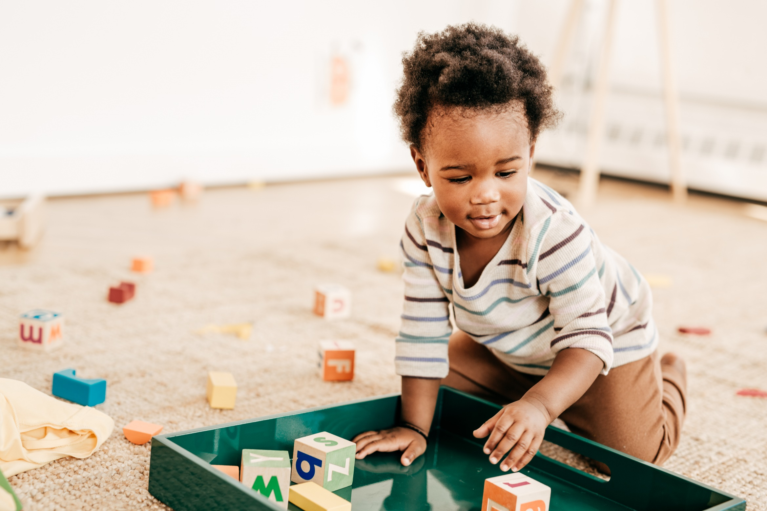
Putting It All Together Daily Routines
General
Diapering
Playing
Feeding/Eating
Sleeping
Notes:
https://eclkc.ohs.acf.hhs.gov/safety-practices/article/tips-keeping-infants-toddlers-safe-developmental-guide-home-visitors

Slide 51
Putting It All Together Daily Routines
General
Diapering
Playing
Feeding/Eating
Sleeping
Notes:
https://eclkc.ohs.acf.hhs.gov/safety-practices/article/tips-keeping-infants-toddlers-safe-developmental-guide-home-visitors
Break out room or small group activity.
Discuss what injury prevention strategies can be used during daily routines.
Assign 5 break out rooms/small groups each will discuss one topic area
Consider the major causes of injuries, the home family child care environment, age and skills of the children in your care and discuss strategies to use during routines.
Debrief

Slide 52
General
Actively Supervise
Create safe spaces
Use safety devices
Check windows
Keep poisons out of reach
Set hot water temperature
Keep hot liquids and foods out of reach
Prevent drowning
Prepare for emergencies
Notes:
Safety Tip No. 1: Actively supervise
What families can do: Make sure that you can see and reach your baby at all times when they are moving about. You can use a playpen for short periods of time (15 minutes) when you can’t give your baby your full attention. Your home visitor can talk to you about these Active Supervision strategies:
Create safe spaces by:
Arranging furniture and household items so you can always see your baby
Identifying a safe area for him to explore
Being aware of a baby’s movements, as infants may roll, crawl, or creep into pathways of unsuspecting adults and older children in the home
Making sure that only age-appropriate items are within your baby’s reach, and that all furniture is properly secured or bolted to the wall. It is not safe to put items in a playpen that your baby can use to climb out.
Stay close by so you can reach your baby quickly if needed.
Keep a watchful eye. Know where your baby is and what he is doing, as well as what older children and family members are doing in an area where mobile infants are playing.
Listen. Notice typical as well as unusual noises or silence that could signal distress.
Anticipate what your baby wants or may try to do.
Engage and redirect. Even when you are busy, you can stay engaged by talking or singing to your baby about what you are doing. If necessary, intervene quickly before your baby does something that is not safe.
Why it works: Mobile infants continue to change constantly and demonstrate new interests and abilities. Once they can freely explore their world, any area they can reach must be free of small items that could be choking hazards. Babies may suddenly try to climb over or crawl under furniture, or out of a crib or playpen. Properly securing or bolting furniture to the wall prevents it from tipping over if infants use it to pull up to stand, cruise, or climb. Active Supervision is a way to stay engaged, pay attention, and help mobile infants practice their new skills safely.
Safety Tip No. 2: Use a checklist to create safe environments
What families can do: Use a home safety checklist¹¹ to identify and regularly inspect household items and infant furniture and equipment to make sure that they are safe. For example, check for splinters, sharp edges, loose pieces, or tears in a playpen that could injure an infant.
Why it works: Infants need safe places to learn and grow. As children learn new skills, their interaction with the environment changes, leading to new safety risks. Using a home safety checklist, and keeping in mind an infant’s needs and developmental abilities now and in the weeks to come, can help you identify possible hazards so you can remove, repair, and keep your baby away from any objects that could be harmful.
Safety Tip No. 3: Use safety devices
What families can do: Get and use smoke alarms and carbon monoxide detectors. Properly installed and maintained smoke alarms and carbon monoxide detectors save lives. Follow manufacturer’s recommendations for where to place them. Your home visitor may be able to help you obtain these devices for free or at a reduced cost. Make a schedule to check the batteries routinely to make sure they work and replace them once a year. Have a fire escape plan that describes who will get the children out of the house and where you will meet once outside. Use safety devices such as outlet covers, cabinet locks, and baby gates.
Why it works: Smoke alarms warn you that there is a fire so you can get your family out of the building quickly. Carbon monoxide (CO) is a deadly, poisonous, odorless, and colorless gas. It may come from home heating and cooking devices. An alarm alerts you to unsafe CO levels in the home. Simple safety devices like outlet covers, cabinet locks, and baby gates prevent injuries and are not expensive. It is always best to plan ahead when child proofing your home so that as a mobile infant develops new skills and abilities, you know that your baby can explore safely.
Safety Tip No. 4: Make sure that windows are safe
What to do: Keep cribs, furniture, toys, and other objects away from windows and blind cords. Curtains or cordless shades are safer than Roman shades or blinds with cords. Secure the cords and chains from window coverings [PDF, 145KB] so they are up and out of reach. Make sure windows either open from the top or have guards so they can’t open more than four inches.
Why it works: Cords from window blinds are a strangulation hazard. Inexpensive cord safety devices are available from retail stores if you have blinds with cords. Windows can be a source of falls even when they are closed, and can pose a hazard to infants who are developing new motor skills and becoming more active every day. A window screen is not designed to protect a child from falling.
Safety Tip No. 5: Be aware of and keep all poisons out of children’s reach
What families can do: If you live in a house or apartment built before 1978, it may have lead paint. You can talk to your home visitor as well as your landlord, health care provider, and local health department to find out if you have lead paint in your home, and if so, what to do. Infants learn about their environment by exploring objects using all of their senses. Inspect your home for poisonous materials. Check to make sure indoor and outdoor plants [PDF, 197KB] are not poisonous. Place all cleaning products, chemicals, and toxic materials in locked cabinets. Craft and play materials should say they are "non-toxic." Keep any products that say "keep out of reach of children" and everyday items like toothpaste out of reach. Store medications up and away. Make sure that people who live with or visit you put away their coats, purses, bags, and backpacks so that your baby cannot reach inside for medications [PDF, 455KB] or other unsafe items. Avoid using chemicals near your baby. Post Poison Control information in a central location.
Why it works: There are many poisons throughout the home. Some are obvious, but others may be harder to identify. According to Safe Kids Worldwide, "every minute of every day, a poison control center answers a call about a young child getting into medicine."¹² Indoor and outdoor plants, paint, craft materials, and medications are hazardous when mobile infants put them in their mouths or spill chemicals on their skin. A small amount of lead is harmful to a child who swallows or breathes in dust that you may not even be able to see. Even everyday items like makeup and toothpaste can be poisonous if eaten in large quantities. To keep babies safe, store toxic products in locked cabinets and keep personal items out of children's reach.
Safety Tip No. 6: Check the temperature of your hot water
What families can do: Set the temperature on your hot water heater to 120 degrees Fahrenheit or lower and check the water temperature on the inside of your wrist before bathing your baby.
Why it works: Infants have thin skin that burns easily. Babies can’t get out of a bathtub safely by themselves if the water is too hot. To prevent burns from scalding water in the tub or sink, make sure that the temperature on your water heater is not higher than 120 degrees.
Safety Tip No. 7: Keep hot foods and liquids out of reach
What families can do: Don’t hold your baby when you are holding hot food or a hot beverage, cooking on the stove, or taking food out of the microwave. Place hot liquids and foods in the center of the counter or a table that is not at your child’s level. Make sure that the microwave and cords from appliances that may contain hot liquid, such as a coffee pot or crock pot, are not in reach. Keep pots on the back burner of the stove with the handles turned inward. When using the microwave or stove, it is not safe for a mobile infant to be in the kitchen without supervision.
Why it works: Hot liquids and steam are more likely to burn or scald infants, as their skin can burn from even brief contact with a hot substance that adults find comfortable. Infants are curious and have a strong grasp. If they grab a dangling cord, tablecloth, or your arm when you are holding hot food or drinks, the food or liquid can spill on them. In one study, 90.4 percent of scald injuries to children under age 5 were related to hot cooking or drinking liquids.¹³ Using a baby gate so your baby can’t go into the kitchen without you when you are cooking can prevent burns to a young child.
Safety Tip No. 8: Prevent drowning
What families can do: Always stay hands-on when bathing your infant. Never leave an infant alone in the water. Be aware of any body of water around the home such as pools, ponds, or lakes. Children ages 1 to 4 have the highest drowning rates.¹⁴ Most occur in home swimming pools. If you live in a house that has a pool, make sure that it has fencing on all sides and has "self-closing and self-latching gates that open outward, with latches that are out of the reach of children."¹⁵ Keep a phone with you, and learn child cardiopulmonary resuscitation (CPR). Empty buckets and turn them upside down when done. Close the lids to toilets and washing machines. Stay actively engaged whenever a child is in or near water.
Why it works: Drowning happens quickly and silently. An infant or small child can drown within 30 seconds in as little as two inches of liquid, so stay hands-on and actively engaged whenever a child is in or near any water. Mobile infants are curious explorers and can lean inside a bucket or reach for a toy in the pool, but their heads are bigger than their bodies. If they fall in, they are unable to get out and can drown.
Safety Tip No. 9: Prepare for emergencies
What families can do: Post important emergency phone numbers such as poison control, 911, and your child’s doctor in a central location, and store them in your mobile phone. This is especially important if your child has a special health care need. Prepare for common weather-related emergencies. Keep basic first aid and disaster supplies and instructions on hand. You also can talk to your home visitor about opportunities to learn child CPR and first aid.
Why it works: Families that prepare for emergencies have a better chance of getting help quickly when needed. Emergency responders and poison control professionals can provide instruction about first aid treatment for different types of injuries.
Safety Tip No. 10: Always use a car seat for your child
What families can do: Select a car seat based on your child’s age and size, and that fits in your vehicle, and use it every time your child rides in your car or truck. Install the car seat according to the manufacturer’s instructions to ensure that it protects your child. Infants should ride in the back seat in a rear-facing car seat until they reach the top height or weight limit allowed by the car seat’s manufacturer. The safest place for children to sit is the back seat. Find an inspector who can check your child’s car seat and make sure it is installed correctly.
Why it works: Motor vehicles are the second leading cause of death among children ages birth to 4.¹⁶ The best way to protect your child from injury in a crash is to make sure that they are always seated in the back seat in a car seat that is appropriate for their age and size. Using a car seat reduces the risk of death in passenger vehicles by 71% for infants younger than age 1 and by 54% for toddlers ages 1–4.¹⁷ Infants and young children are more likely to be hurt in the front seat. Front air bags are designed to protect adults, not children, and can be dangerous to children seated in front of them.

Slide 53
Diapering
Notes:
Safety Tip No. 1: Stay hands-on and engaged
What families can do: Have everything you need to change your baby’s diaper before you start. Keep a hand on mobile infants whenever they are on a changing table or other raised surface. Engaging infants in reciprocal (back and forth) play, such as singing, rhyming, and echoing verbalizations, supports a nurturing relationship between you and your baby. It also provides opportunities for early learning.
Why it works: Mobile infants are constantly testing what their bodies can do. They are able to roll and crawl, and may attempt to scoot forward or backward. It is important to never leave them alone because their movements may be unpredictable. Staying hands-on can prevent an infant from falling off a changing table or other high surface. Providing a positive, engaging activity during diapering creates learning opportunities for your baby and focuses his attention.
Safety Tip No. 2: Store diapering supplies safely
What families can do: Keep diaper changing materials, including wipes and ointments, where you can reach them easily but are away from an infant’s grasp. You can give your baby a safe, washable toy to hold while diapering. Wash the diaper changing area[PDF, 350KB] after each use and store the supplies out of an infant’s reach.
Why it works: Mobile infants use their hands and mouth to explore their environment. They are able to pick up and mouth materials that are within their reach. Providing a safe toy to interest your baby and keeping spray bottles, disinfectant wipes, ointments, medications, and other harmful materials out of reach protects children from injury.

Slide 54
Playing
Notes:
Safety Tip No. 1: Use toys, equipment, and materials that have no small parts and are safe for young infants.
What families can do: Only provide toys that are safe for mobile infants. Use materials that are sturdy and easy to clean, because babies will put them in their mouths. Make sure that materials and equipment, including dolls and stuffed animals, do not have loose, small parts that could fall off and pose a choking hazard. Keep all objects that are small enough to fit into an infant's mouth out of reach. Any object is dangerous if it can pass through a small-parts cylinder (2.25 inches long by 1.25 inches wide) used for screening choking hazards for children younger than 3 years. For more information, see Which Toy for Which Child: A Consumer's Guide for Selecting Suitable Toys [PDF, 1.2MB]. Make sure that there are no button batteries or magnets within reach that an infant could swallow.
Select equipment that will not trap an infant’s head or limbs and is appropriate for your baby’s height and weight. Always use safety straps. To find out if safety concerns have been reported about the toys and equipment you are using, you can search for product safety complaints or report a concern at www.saferproducts.gov. Sign up for recall notices from the U.S. Consumer Product Safety Commission.
Why it works: Mobile infants are learning to transfer objects from hand to hand and hand to mouth. They explore their world through their senses, and often touch and mouth objects. With their greater mobility, they are excited about exploring their physical environment. Most infants do not have a sense of danger or caution and need safe equipment and materials to reduce the risk of injury. Providing toys and materials that contain no small or loose parts eliminates choking hazards. Storing button batteries and magnets out of reach removes hazardous materials. Placing heavier items on lower shelving reduces the risk of injury from a dropped toy. Age-appropriate equipment prevents injuries from entrapment, choking, and strangulation. Safety straps secure a child in a stroller, swing, rocker, or other equipment and reduce the risk of falls.
Safety Tip No. 2: Provide safe outdoor play environments
What families can do: Learning about the natural world is fun for families and children of all ages, including mobile infants. Supervise children carefully in any outdoor play area. Limit sun exposure between 10 a.m. and 4 p.m. Dress infants appropriately, and keep them inside during extreme heat or cold. In warm weather, dress your baby in light clothing to cover her skin and use a wide-brimmed hat. For infants older than 6 months of age, apply sunscreen to all exposed areas at least 30 minutes before going outside and every two hours afterwards. Bring and encourage drinking water often. Keep your baby away from poisonous plants [PDF, 197KB] and any insects that may sting or bite.
Why it works: All children need opportunities to play outside as well as inside. Providing opportunities to explore the sights and sounds in nature supports children’s development when these experiences are safe and well-supervised. Using sunscreen and a hat protects an infant from sunburn. Providing fluids frequently prevents dehydration. Knowing how to recognize plants that are poisonous and making sure that there are no insects that sting or bite protects children from injury. Mobile infants are not able to regulate their body temperature well, so keeping them inside during extreme heat or cold protects them from overheating and frostbite.

Slide 55
Feeding

Slide 56
Sleeping

Slide 57
Poll: Home Safety Checklist
Yes
No
Never heard about a home safety checklist
Would like to know about home safety checklist
Notes:
Poll
Do you use a home safety checklist with families?

Slide 58
Sample Home Safety Checklists
American Academy of Pediatrics Injury Prevention Program
Kidshealth.org
Massachusetts Department of Public Health
Minnesota Department of Health
Notes:
Notes
Some of you may find it helpful to review sample checklists for your own learning, to become more familiar with injury prevention strategies indoors.
But remember, no checklist can address every potential hazard. For example, many checklists do not address how to store guns and ammunition safely to protect children. But if one of your families own a firearm, you may want to talk about this topic.
The American Academy of Pediatrics Injury Prevention Program has developed a series of checklists known as the TIPP sheet. Each safety checklist is organized by the child's age. These checklists are available in English and Spanish.
Kidshealth.org is a website for parents, developed by the Nemours Foundation and it has a series of safety checklists. This website highlights the multiple hazards in each room but also includes some topical information.
The Massachusetts Department of Public Health developed a sample checklist. It also approaches home safety by encouraging families to think about the hazards in each room. This checklist is also available in English, Spanish, and Portuguese.
Our last example of a home safety checklist is from the Minnesota Department of Health. It has a home safety checklist in English and Spanish that is easy to read and can help FCC providers and families think about what they can do to make their home a safer place for children.

Slide 59
ACTIVITY
Notes:
Optional Activity
Choose a checklist
Break into small groups/breakout rooms
Review the checklist and consider
What is new or different
How can you use this in your program
How frequently can you use a checklist
Strategies to improve the checklist

Slide 60
Resources
Caring for our Children
Centers for Disease Control and Prevention
State Department of Public Health
Connecticut Office of Early Childhood
Notes:
Notes:
Resources to extend your own learning include:
Caring for our Children - https://nrckids.org/CFOC
Centers for Disease Control and Prevention - https://www.cdc.gov/coronavirus/2019-ncov/community/schools-childcare/child-care-guidance.html
State Department of Public Health - https://portal.ct.gov/DPH
Connecticut Office of Early Childhood - https://www.ctoec.org/
Additional Resources:
https://childcare.extension.org/creating-a-child-care-environment-that-supports-childrens-exploration/
https://www.virtuallabschool.org/preschool/safe-environments/lesson-1
Checklist example: Indoor and Outdoor Safety Checklist for Child Care Centers
https://www.procaresoftware.com/resources/indoor-and-outdoor-safety-checklist-for-child-care-centers/#:~:text=Make%20sure%20all%20furniture%2C%20equipment,climbed%20on%20by%20a%20child.

Slide 61
What’s your next step?
Type in the chat one action steps you plan to take to increase safety indoors
Notes:
Notes for trainer:
[Presenter: Ask for volunteers to share one action steps they plan to take to increase safety indoors]

Slide 62
Notes:
Time for questions and Answers
https://pixabay.com/photos/town-sign-place-name-sign-support-1699981/

Slide 63
Reaching out
(855) 322 - 2242
ctnurses@gmail.com
www.ctnurses.org/FCC

Slide 64
Thank you!
Click on link to complete evaluation
Download your certificate
Connect with CT Nurses Consultants!

